Slide 1
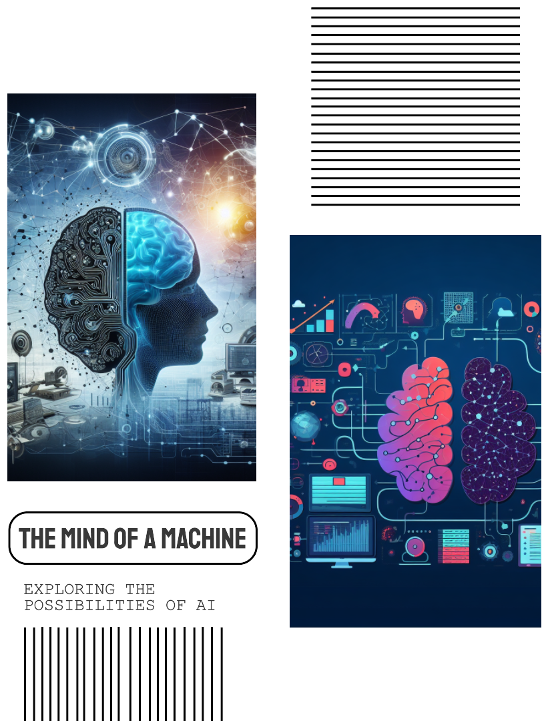
What is the relationship between Machine Learning, Neural Networks, and Deep Learning?
Machine Learning is the broadest term, encompassing all techniques where computers learn from data. Neural Networks are a subset of machine learning, and Deep Learning is an even more specific subset that uses neural networks with many layers. Therefore, all deep learning models are neural networks, but not all neural networks are deep learning models.

